Slide 1
Uncertainty Quantification in the Dynamic Analysis of Offshore Structures
HyeongUk Lim
11/21/2019
Mechanics, Uncertainty, and Simulation in Engineering
The University of Texas at Austin

Slide 2
A Collection of Findings in an Uncertain Grad School Life
HyeongUk Lim
11/21/2019
Mechanics, Uncertainty, and Simulation in Engineering
The University of Texas at Austin

Slide 3
Contributions
Studied surrogate modeling for offshore design problems using a spectral method: Polynomial Chaos Expansion (PCE)
Developed a distribution-free PCE framework to enhance the traditional spectral method
Proposed a 2-step gradient-based dimension reduction and surrogate modeling for high-dimensional multivariate functions
Validated the proposed methods in offshore dynamics problems for Uncertainty Quantification

Slide 4
Contributions
Studied an alternative method
Enhanced the traditional method
Proposed a dimension reduction method
Validated proposed methods for Uncertainty Quantification in offshore design

Slide 5
Uncertainty Quantification in the Dynamic Analysis of Offshore Structures
HyeongUk Lim
11/21/2019
Mechanics, Uncertainty, and Simulation in Engineering
The University of Texas at Austin
Count
Quantity

Slide 6
Uncertainty Quantification in the Dynamic Analysis of Offshore Structures
HyeongUk Lim
11/21/2019
Mechanics, Uncertainty, and Simulation in Engineering
The University of Texas at Austin

Slide 7
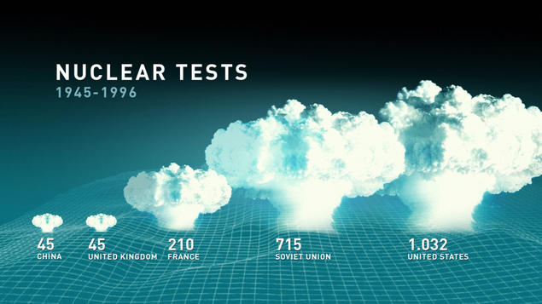
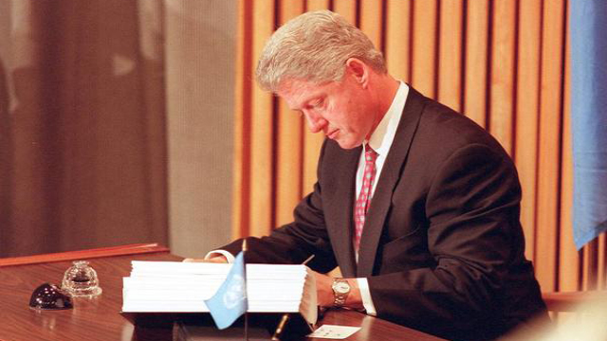
Why Uncertainty Quantification? And since when?
Former President Bill Clinton signing the Comprehensive Nuclear-Test Ban Treaty on September 24, 1996 (CTBTO Photo).
Image sources: norsar.no (left) ; armscontrol.org (right)

Slide 8
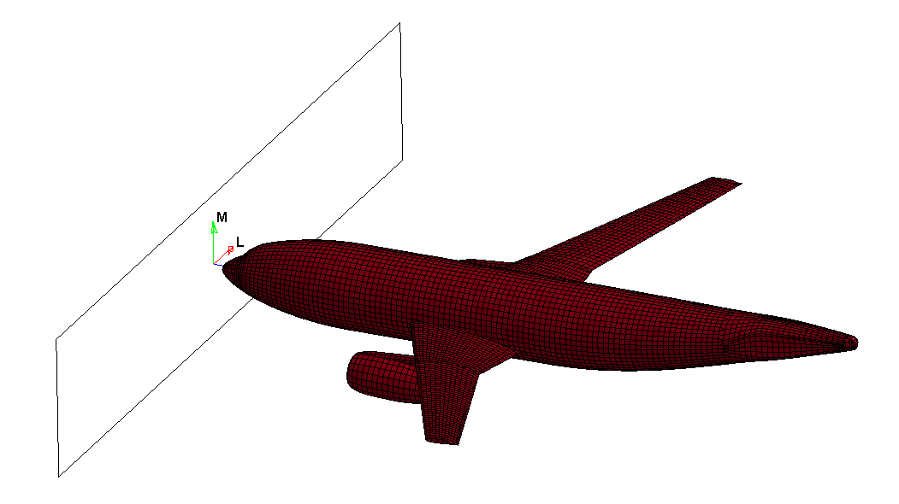
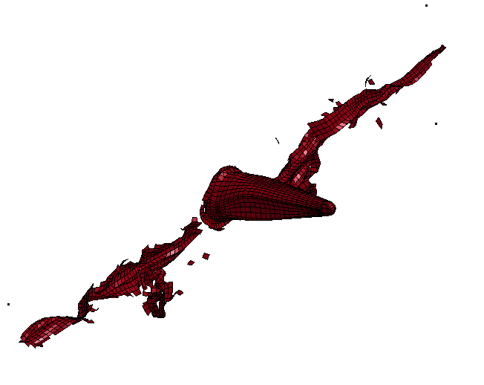
Why the need for Uncertainty Quantification?
They are implementations that are mathematical approximations of the underlying scientific theory
Design verification by computer simulations
But computational models are not scientific theory
Did we build the model right?
➔ Model Verification
Did we build the right model?
➔ Model Validation
Did we account for real-world uncertainties?
➔ Uncertainty Quantification
max impact force?
Computer-Aided Engineering (CAE)
(Peter Qian, 2017)

Slide 9

The use of UQ is growing rapidly …
ScienceDirectsearch statistics for articles with
"Uncertainty Quantification" in title, abstract or author-specified keywords
26867
SAE G-11 Probabilistic
Methods Committee (1998)
AIAA Non-Deterministic Approaches
Conference Technical Committee (1999)
Number of Articles
8489
SIAM/ASA Journal on Uncertainty
Quantification (2013)
2948
188
1047
ASME Journal of Verification,
Validation and Uncertainty
Quantification (2016)
1960-79
1980-90
1991-00
2001-2010
2011-present
(Peter Qian, 2017)

Slide 10
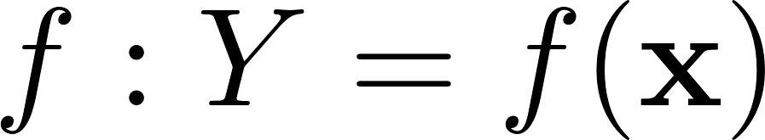
What is Uncertainty Quantification?
Uncertainties in “input” variables are modeled by:
Computation model relates “input” to “response” of interest:
Uncertainty Quantification seeks statistics of “response”:

Slide 11
Uncertainty Quantification in the Dynamic Analysis of Offshore Structures
HyeongUk Lim
11/21/2019
Mechanics, Uncertainty, and Simulation in Engineering
The University of Texas at Austin

Slide 12
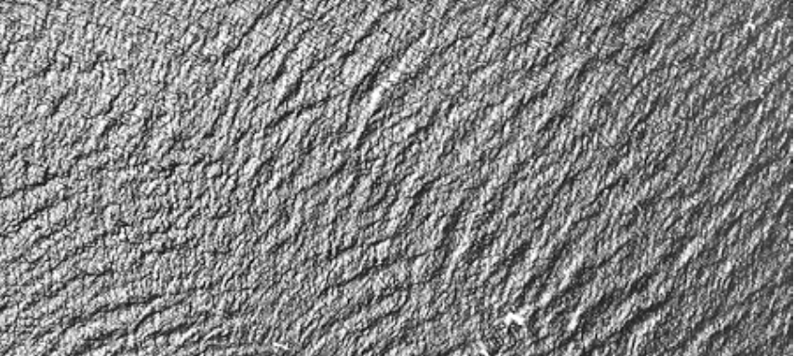
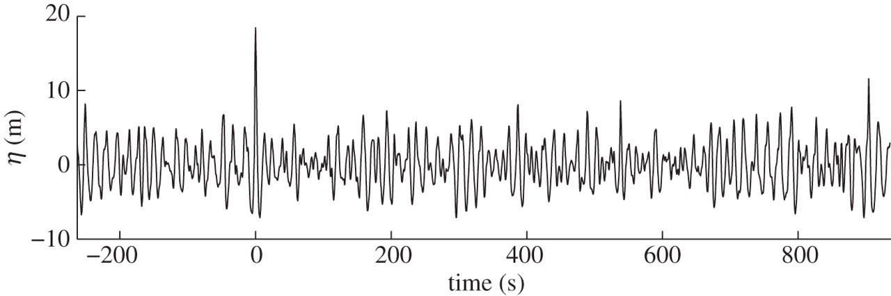
Why UQ for Offshore Structures?
The ocean surface is irregular in space and time:
Ocean surface can be highly variable, with severe extremes (e.g., hurricane)
Aerial photo of ocean waves
Wave elevation time record
(Adcock et al, 2019)
(Fonseca)

Slide 13
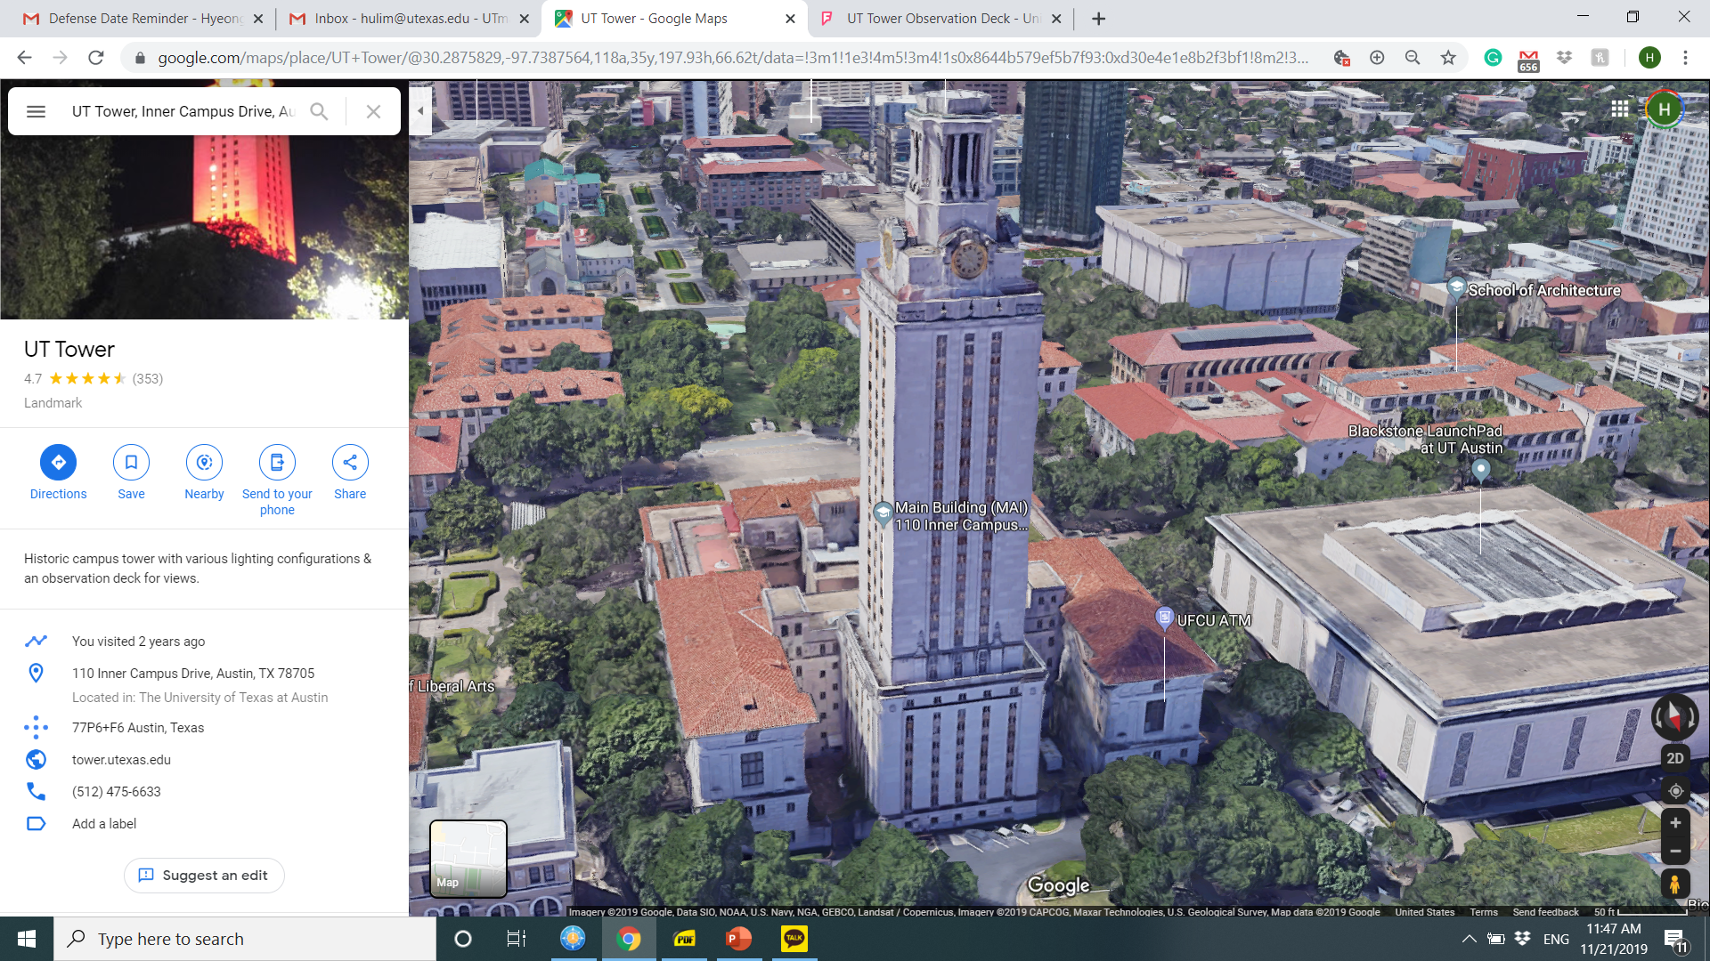
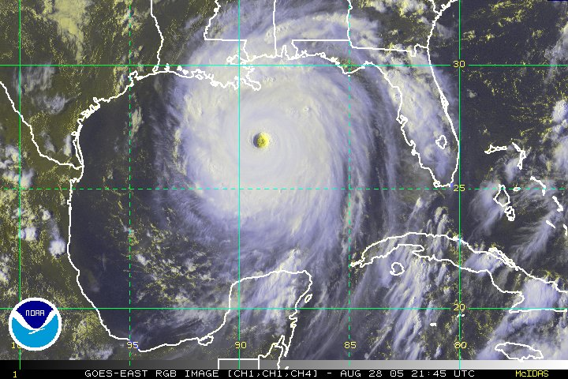
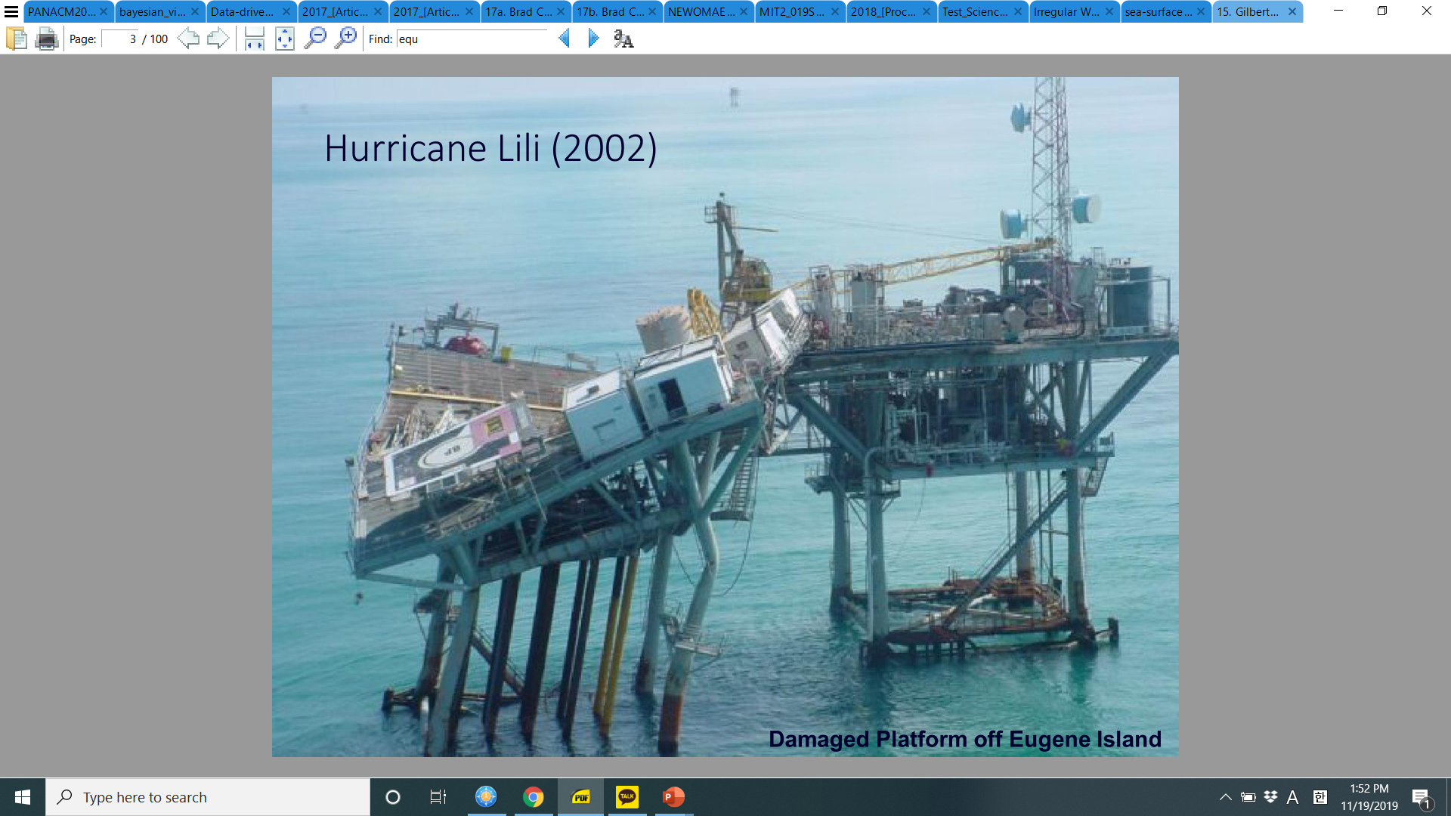
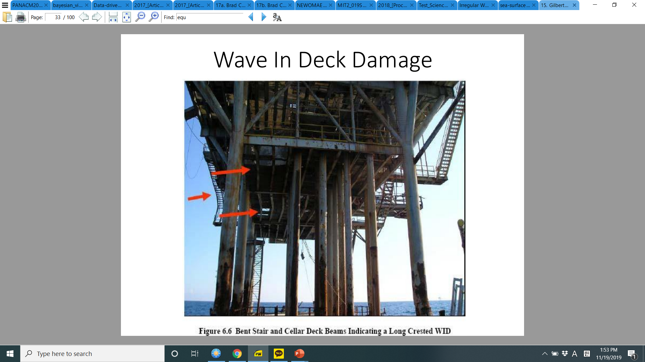
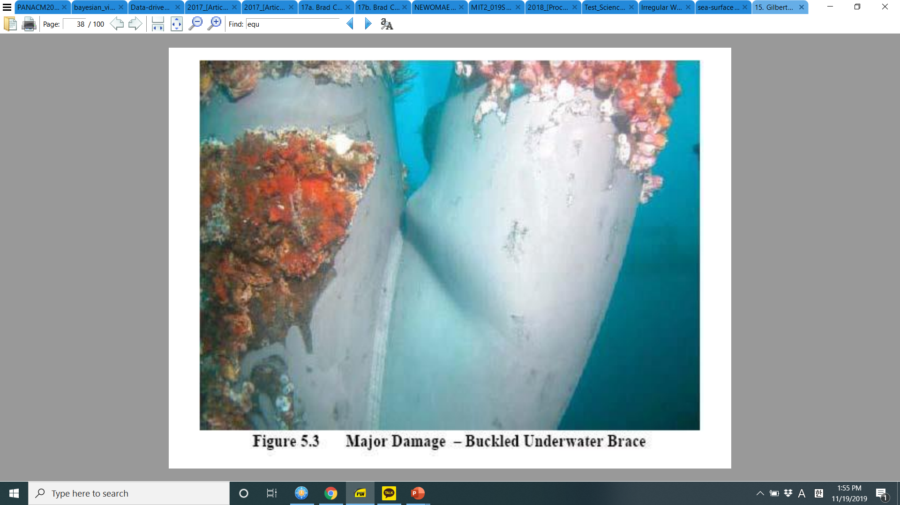
What happens if we fail in UQ studies?
Hurricane Katrina 2005:
Radius: 24 miles
Max. wave height: 91 ft (28 m)
Severe structural damage:
Collapse
Bending
30 m
(NOAA, 2005)
Buckling
(Gilbert, 2019)

Slide 14
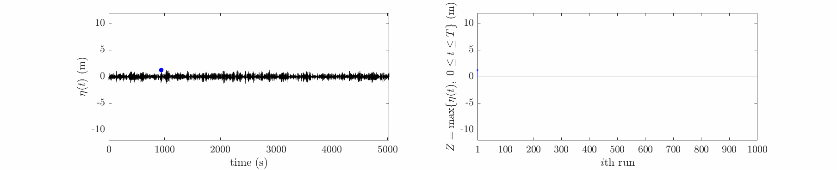
How do we quantify ‘‘Uncertainty’’?
Computational model, f(x): (e.g., stochastic time series simulator)
Steps:
(1) Sample input parameter sets
(2) Propagate to the model
(3) Seek statistics in the computed output
Quantity of Interest: (e.g., maximum value in time series)
Propagation methods:
Monte Carlo simulations in f(x)
: maximum

Slide 15
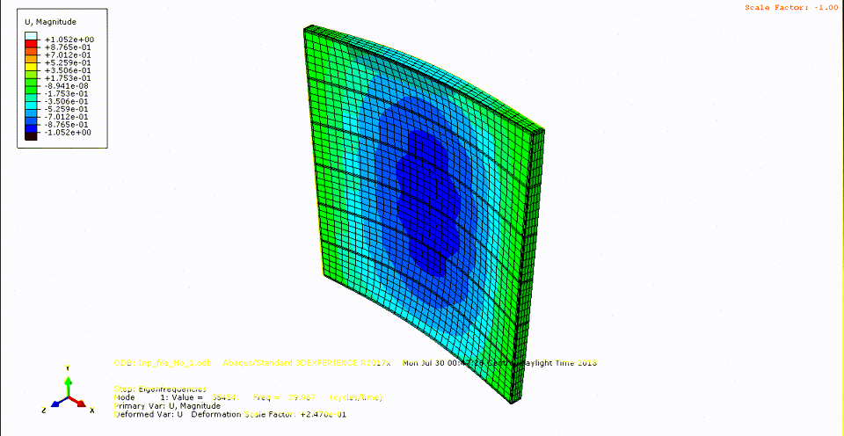
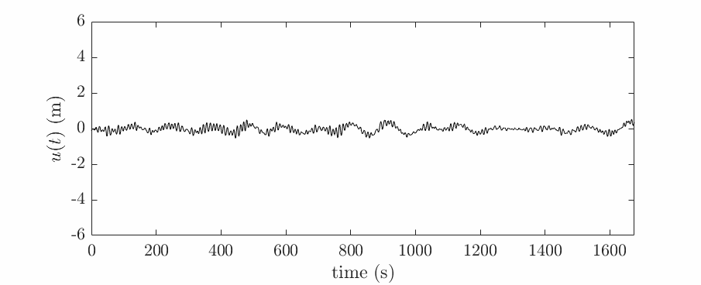
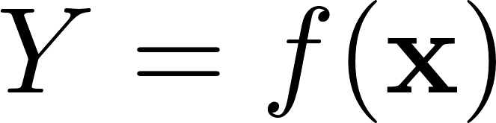
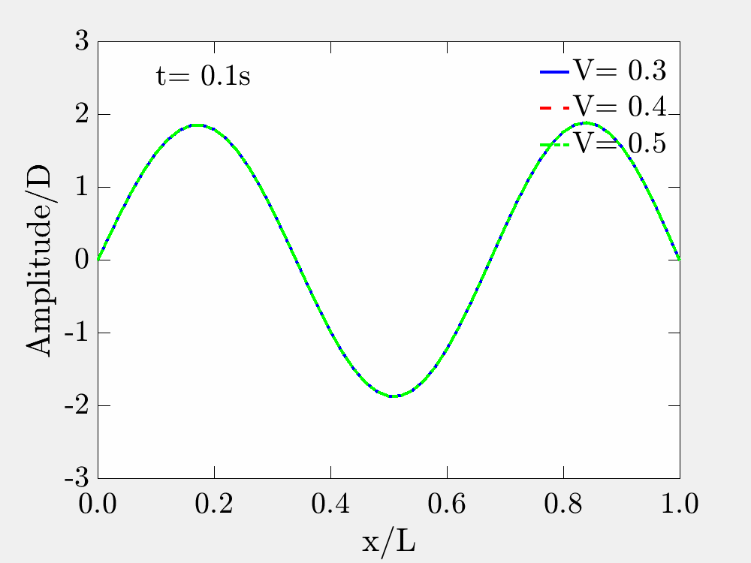
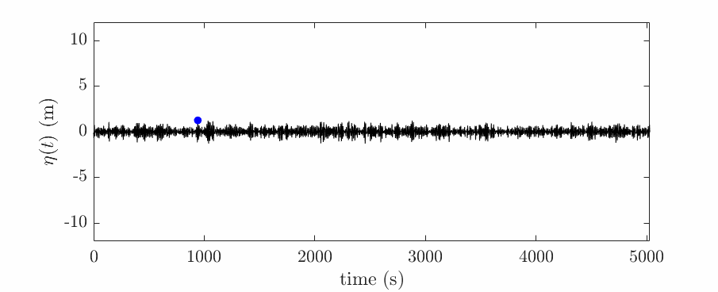
Uncertainty Quantification in the Dynamic Analysis of Offshore Structures
Wood floor response (Lim, Manuel, Persson, and Andersen, 2019)
Floating structure response (surge) (Lim, Manuel, and Low, 2018)
Cross-flow riser response
(Lim, Manuel, Low, and Srinil, 2017)
HyeongUk Lim
11/21/2019
Mechanics, Uncertainty, and Simulation in Engineering
The University of Texas at Austin
Wave elevation (Lim and Manuel, 2019)
(Top)
(Bottom)

Slide 16

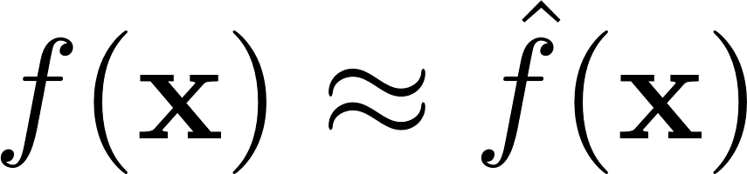
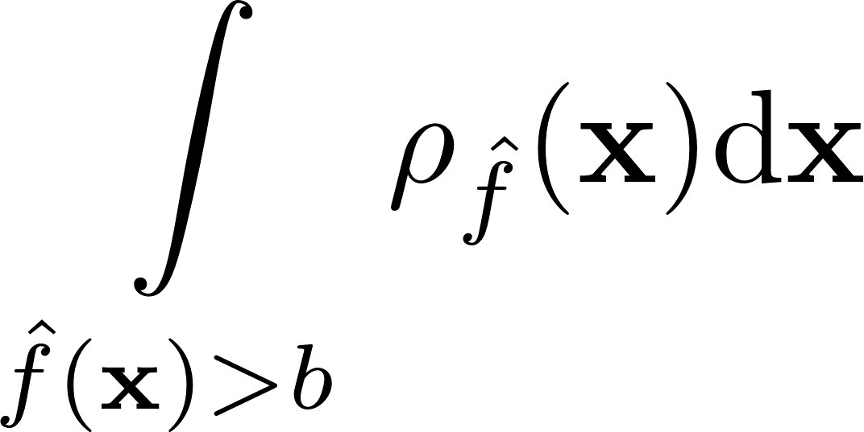
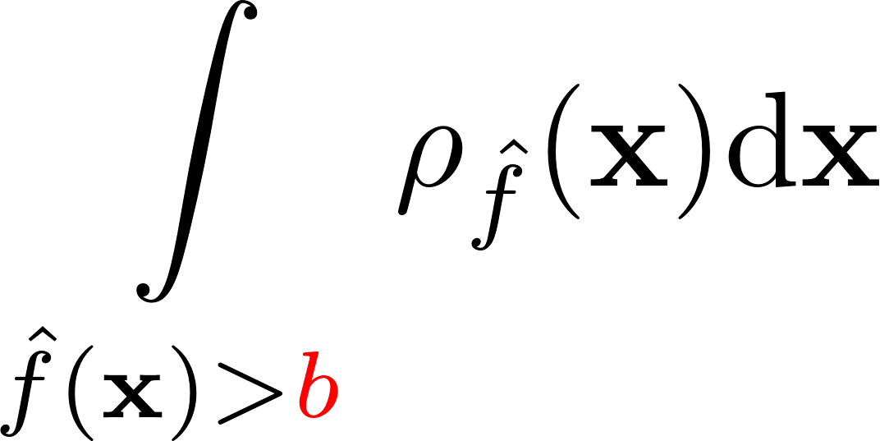

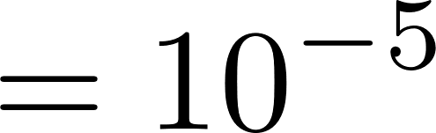

What I have worked on:
Approximation
Integration
Integration

Slide 17
But we face the ‘‘curse of dimensionality’’
Dimension reduction
Sampling strategy
Model order reduction
Dimension | 5 points per dimension | 1 min per run
1 | 5 | 5 min
2 | 5²= 25 | 25 min
3 | 5³= 125 | 2 hours
4 | 5⁴= 625 | 10 hours
5 | 5⁵= 3125 | 2 days
… | … | …
10 | 5¹⁰= 9765625 | 19 years

Slide 18
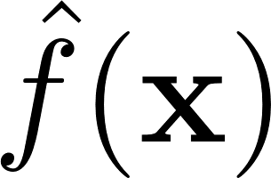
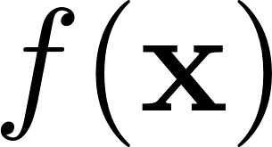
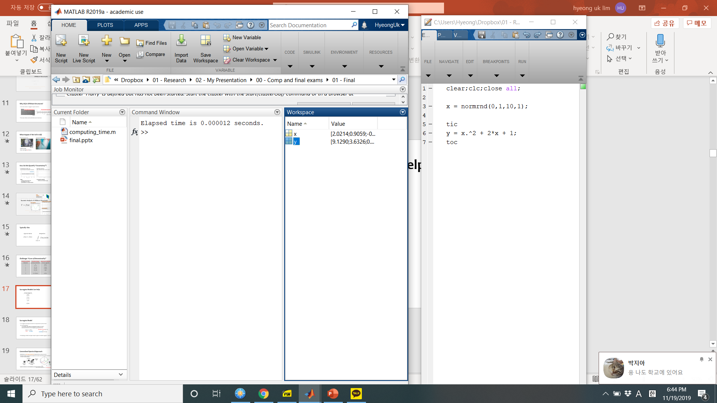
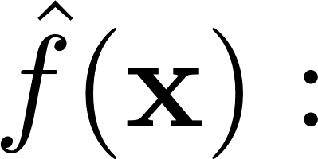
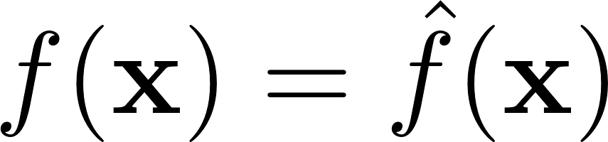
Surrogate Model can help
No. of runs
5
1 min per single run
5 min
10 μs per single run
50 μs
25
25 min
250 μs
125
2 hours
1.25 ms
625
10 hours
6.25 ms
3125
2 days
31.25 ms
…
…
…
9765625
19 years
2 mins

Slide 19
Surrogate Model
A surrogate model approximates a computational model by using:
a small number of the “truth” model runs in construction;
assumed characteristics.
minutes or hours per run
vs.
seconds per 10⁶ runs
truth
surrogate

Slide 20
To name just a few surrogate model approaches:
Wiener Path Integration
Maximum Entropy Distribution
Karhunen-Loeve Expansion
Low Rank Approximation
Generative Adversarial Networks
Polynomial Chaos Expansion
Machine Learning
Principal Hessian Direction
Environmental Contour Method
Active Subspace
Bayesian
Convolutional Neural Network
Subset Simulation
Gaussian Process
Support Vector Machine
Second Order Reliability Method
Deep Learning
First Order Reliability Method
Neural Network
Sliced Inverse Regression
Sliced Average Variance Estimate
Polynomial Dimension Decomposition

Slide 21
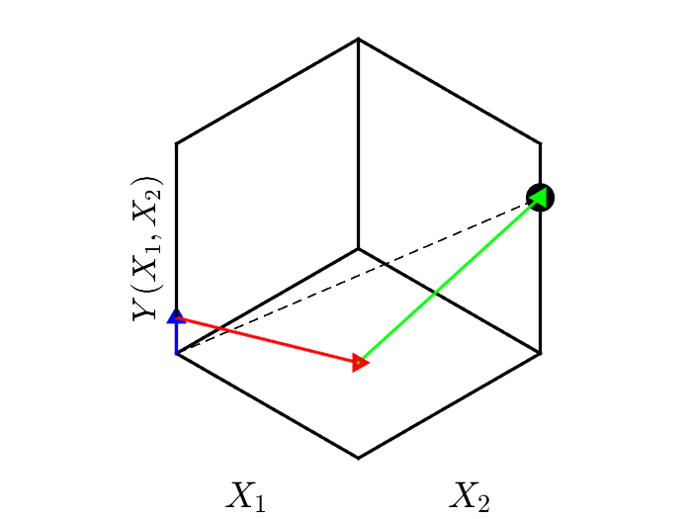
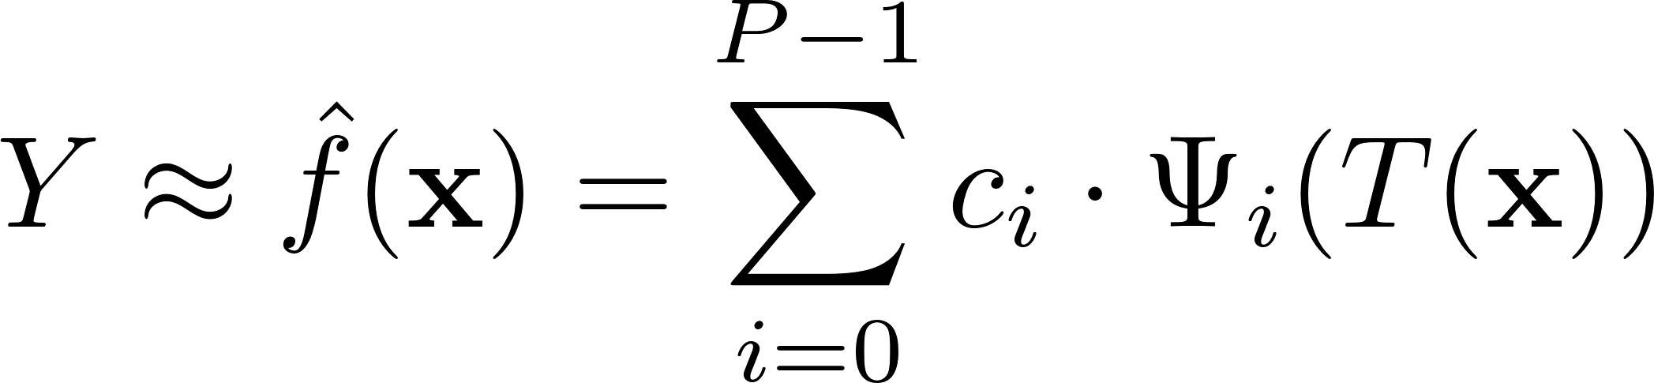


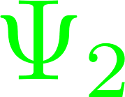

Spectral Approach: Polynomial Chaos Expansion
Use a finite-degree polynomial series expansion to approximate an unknown function.
coordinates
stochastic
input
:
: basis functions
stochastic
output
basis polynomials
in input variables
arrow length: coordinate

Slide 22
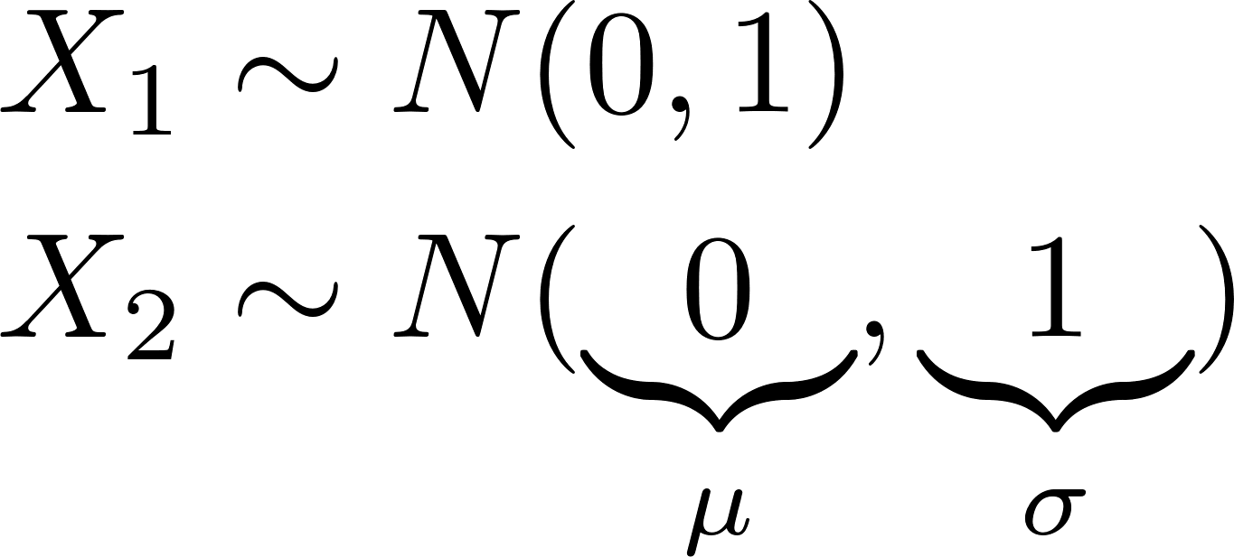
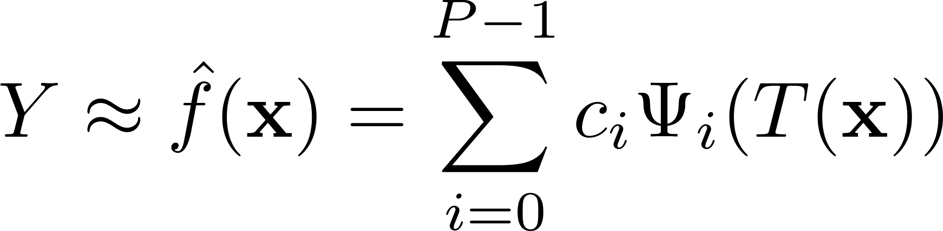
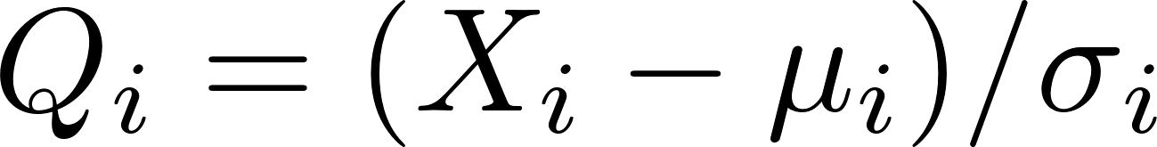
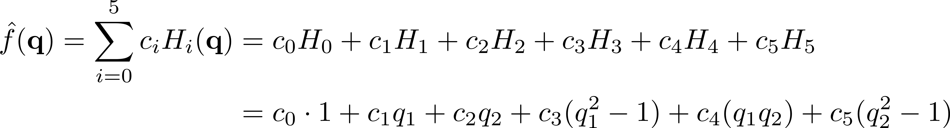
How to use PCE?
Truth model:
PCE model:
Choose basis functions: Hermite polynomials
Variable transformation: [easily generalizable]
Expand:

Slide 23
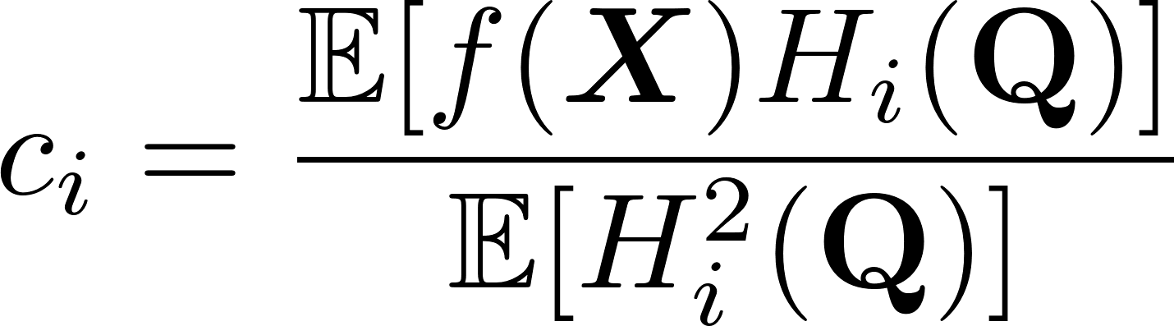
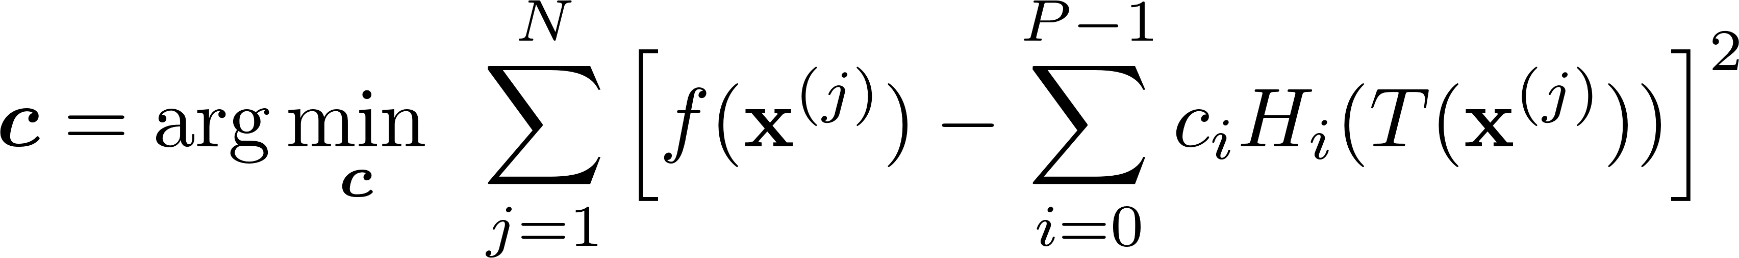
PCE Coefficient Estimation
Spectral projection:
Linear regression:
Coefficient estimation requires some computational runs with the “truth” model.

Slide 24
Contributions
Studied surrogate modeling for offshore design problems using a spectral method: Polynomial Chaos Expansion (PCE)
Developed a distribution-free PCE framework to enhance the traditional spectral method
Proposed a 2-step gradient-based dimension reduction and surrogate modeling for high-dimensional multivariate functions
Validated the proposed methods in offshore dynamics problems for Uncertainty Quantification
Example: Fatigue damage in a marine riser due to vortex-induced vibration

Slide 25
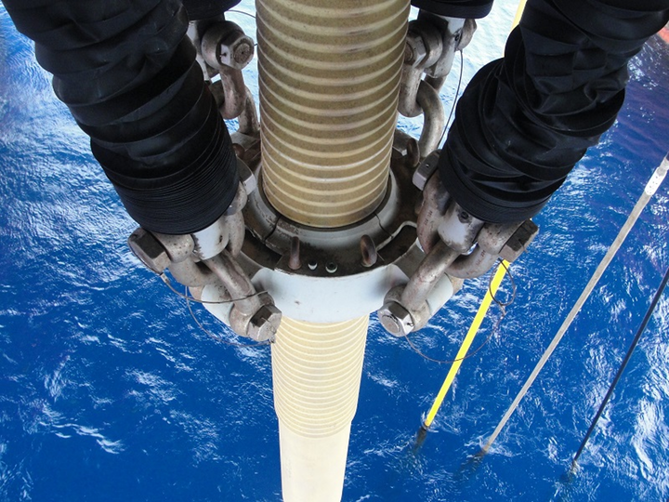
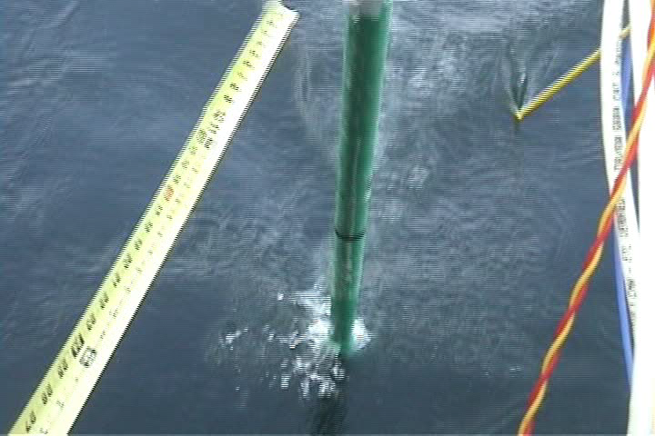
Why we care?
Risers become more vulnerable to VIV as oil and gas development moves to deeper water
VIV prediction is notoriously difficult; current practice relies on very large safety factors
vortex-induced vibration
marine riser
TRACS (tensioned riser assessment for continued service) JIP (joint industry project)
(J. Kim Vandiver's MIT research team)

Slide 26
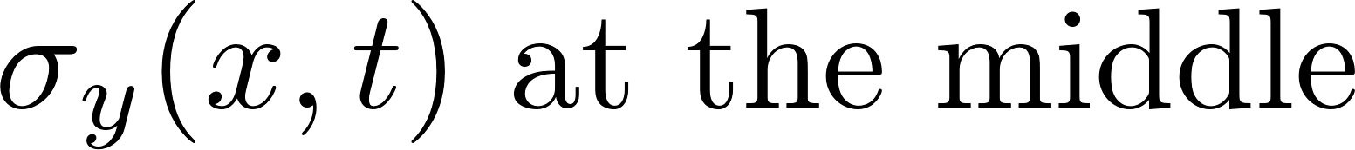

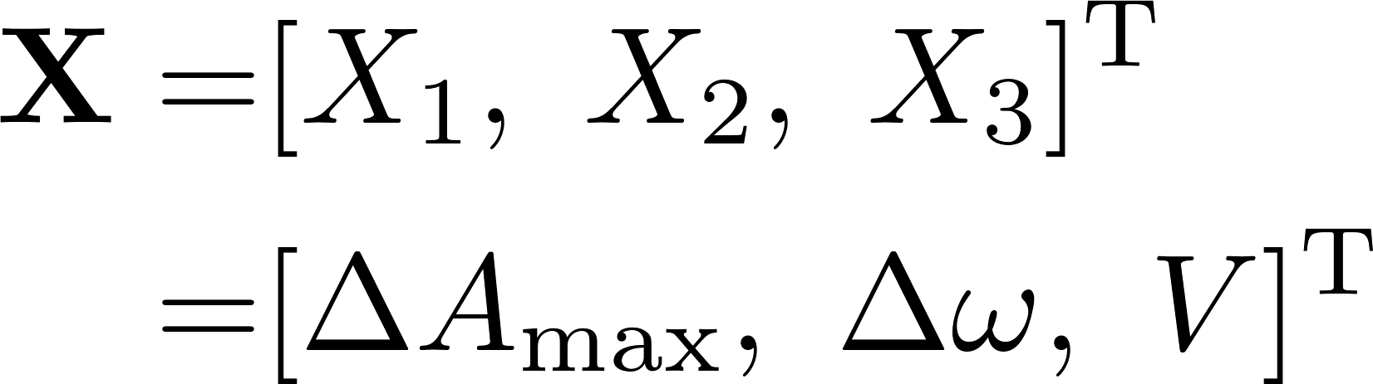
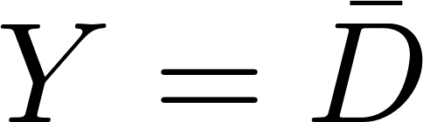
UQ Framework
Input
Partial Differential Equation
Output
Fatigue damage
(normalized)
L: riser length (m)
D: riser diameter (m)
V: uniform current velocity (m/s)
(Top)
(Bottom)

Slide 27
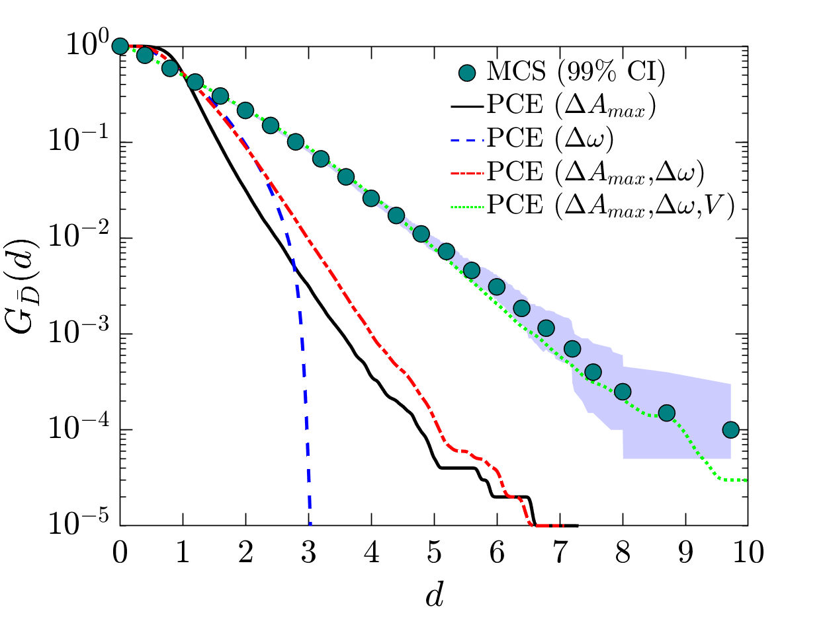
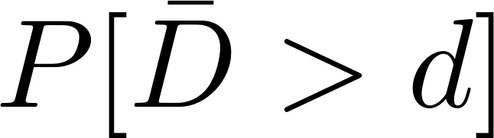
Prediction by different PCE models
PCE surrogate modeling appears to be quite accurate
Exceedance probabilities are within 99% confidence intervals of MCS.

Slide 28
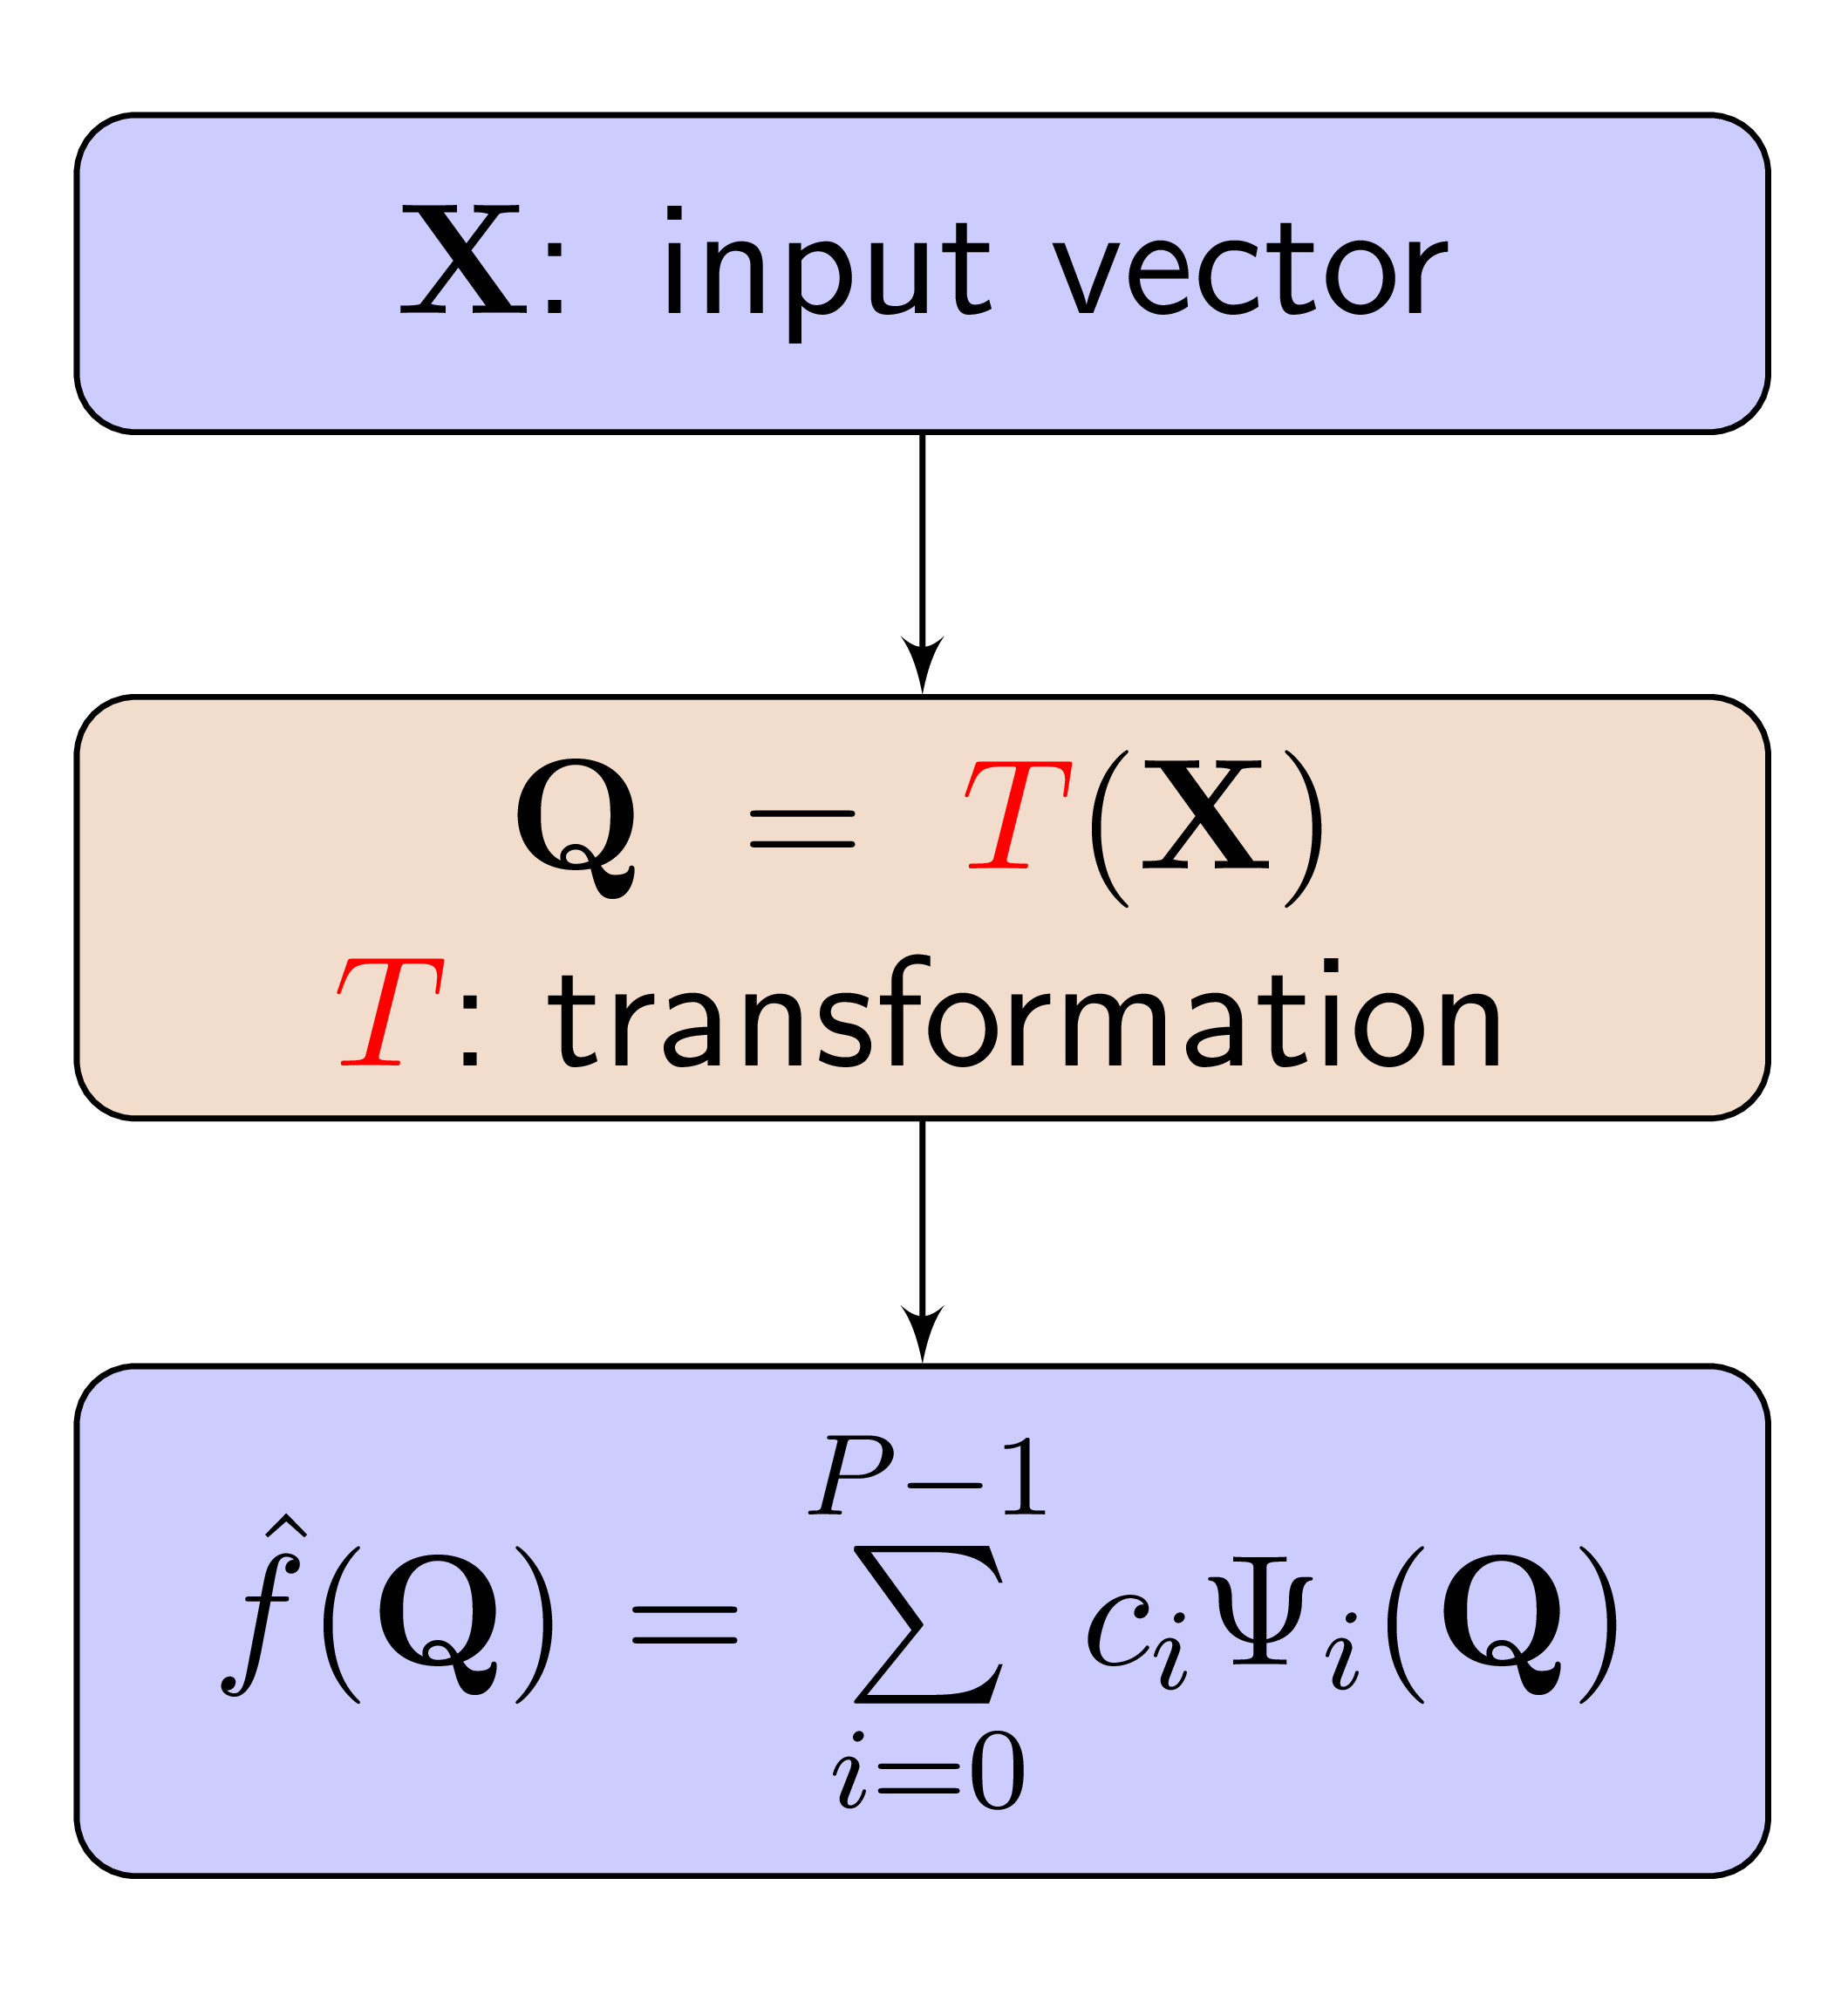
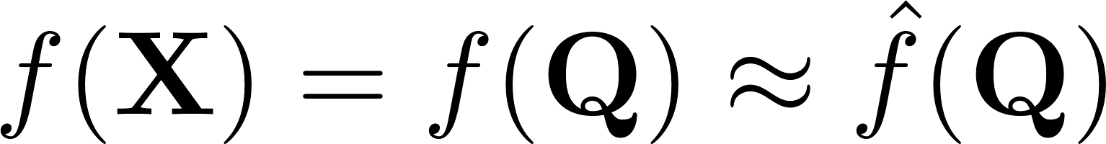
Sometimes PCE doesn’t do a very good job
When f(x) is complex (beyond description by polynomials):
e.g., rational functions
What causes complications?
Underlying distributions AND nonlinear transformations
truth model in X domain
truth model in Q domain
surrogate in Q domain

Slide 29
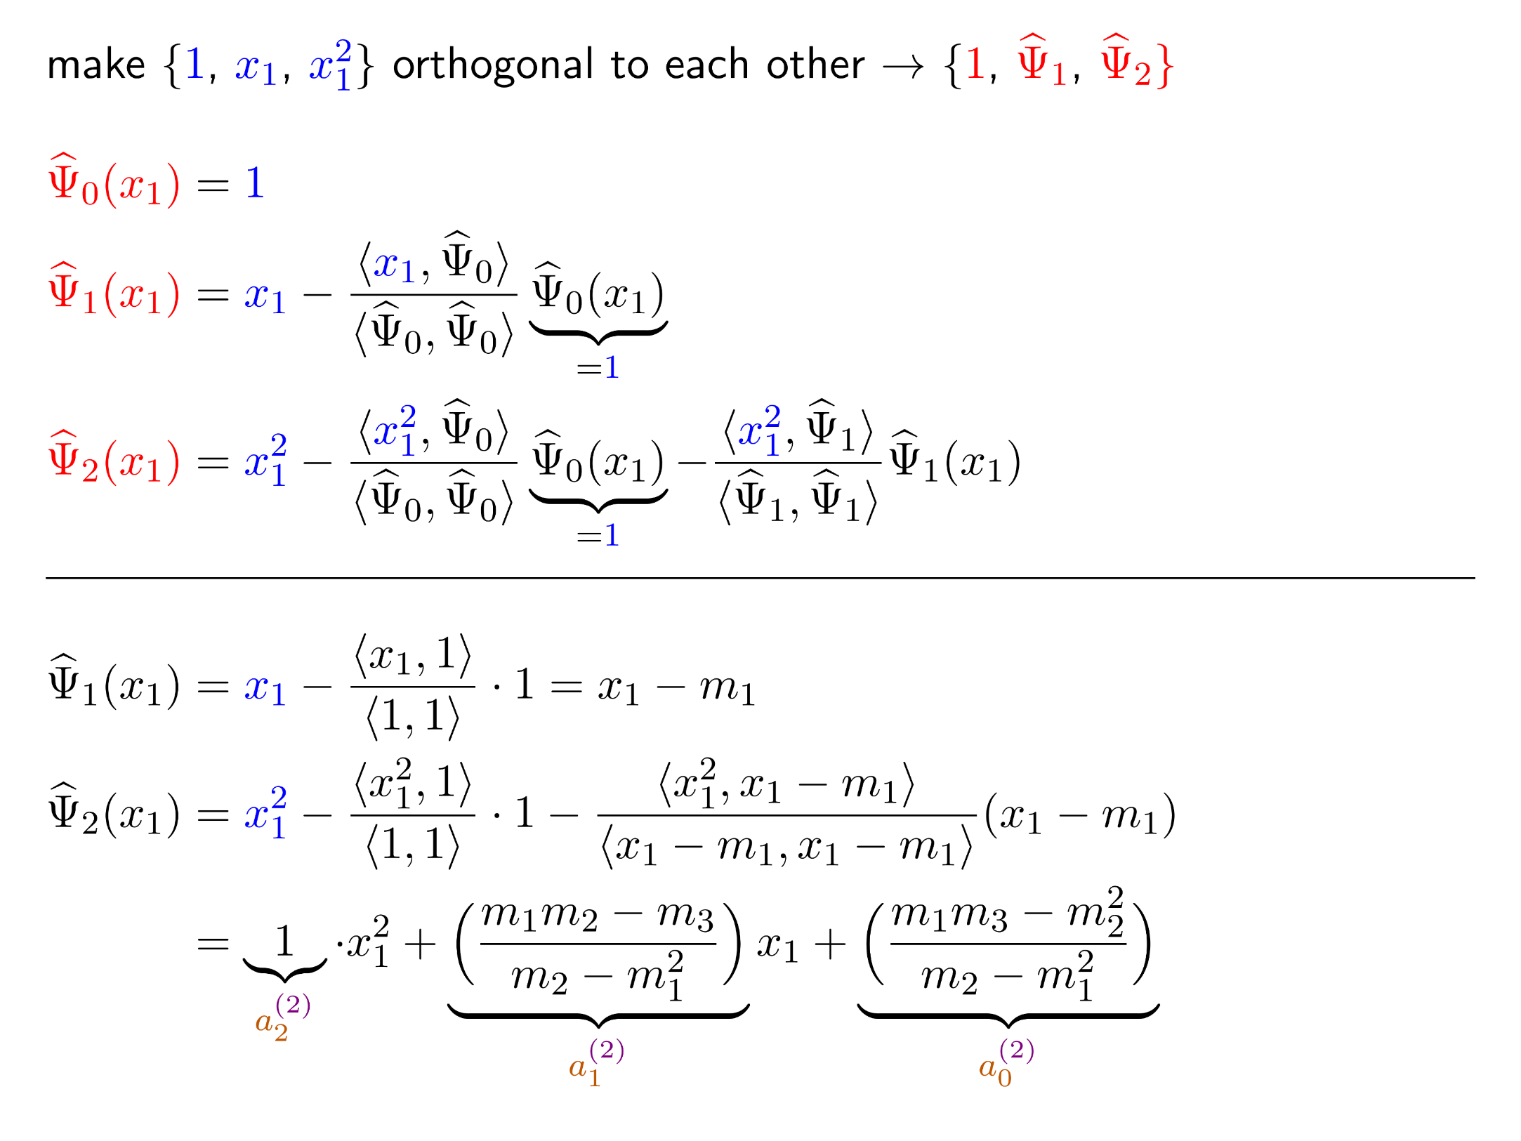
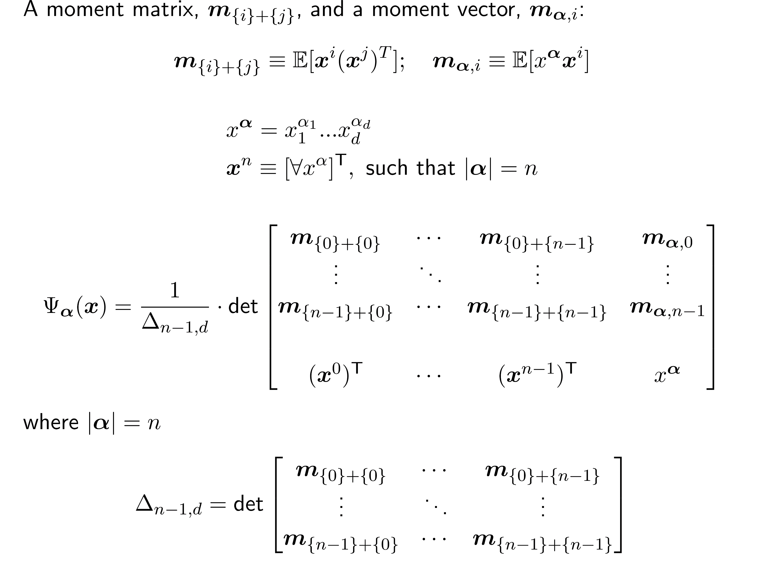
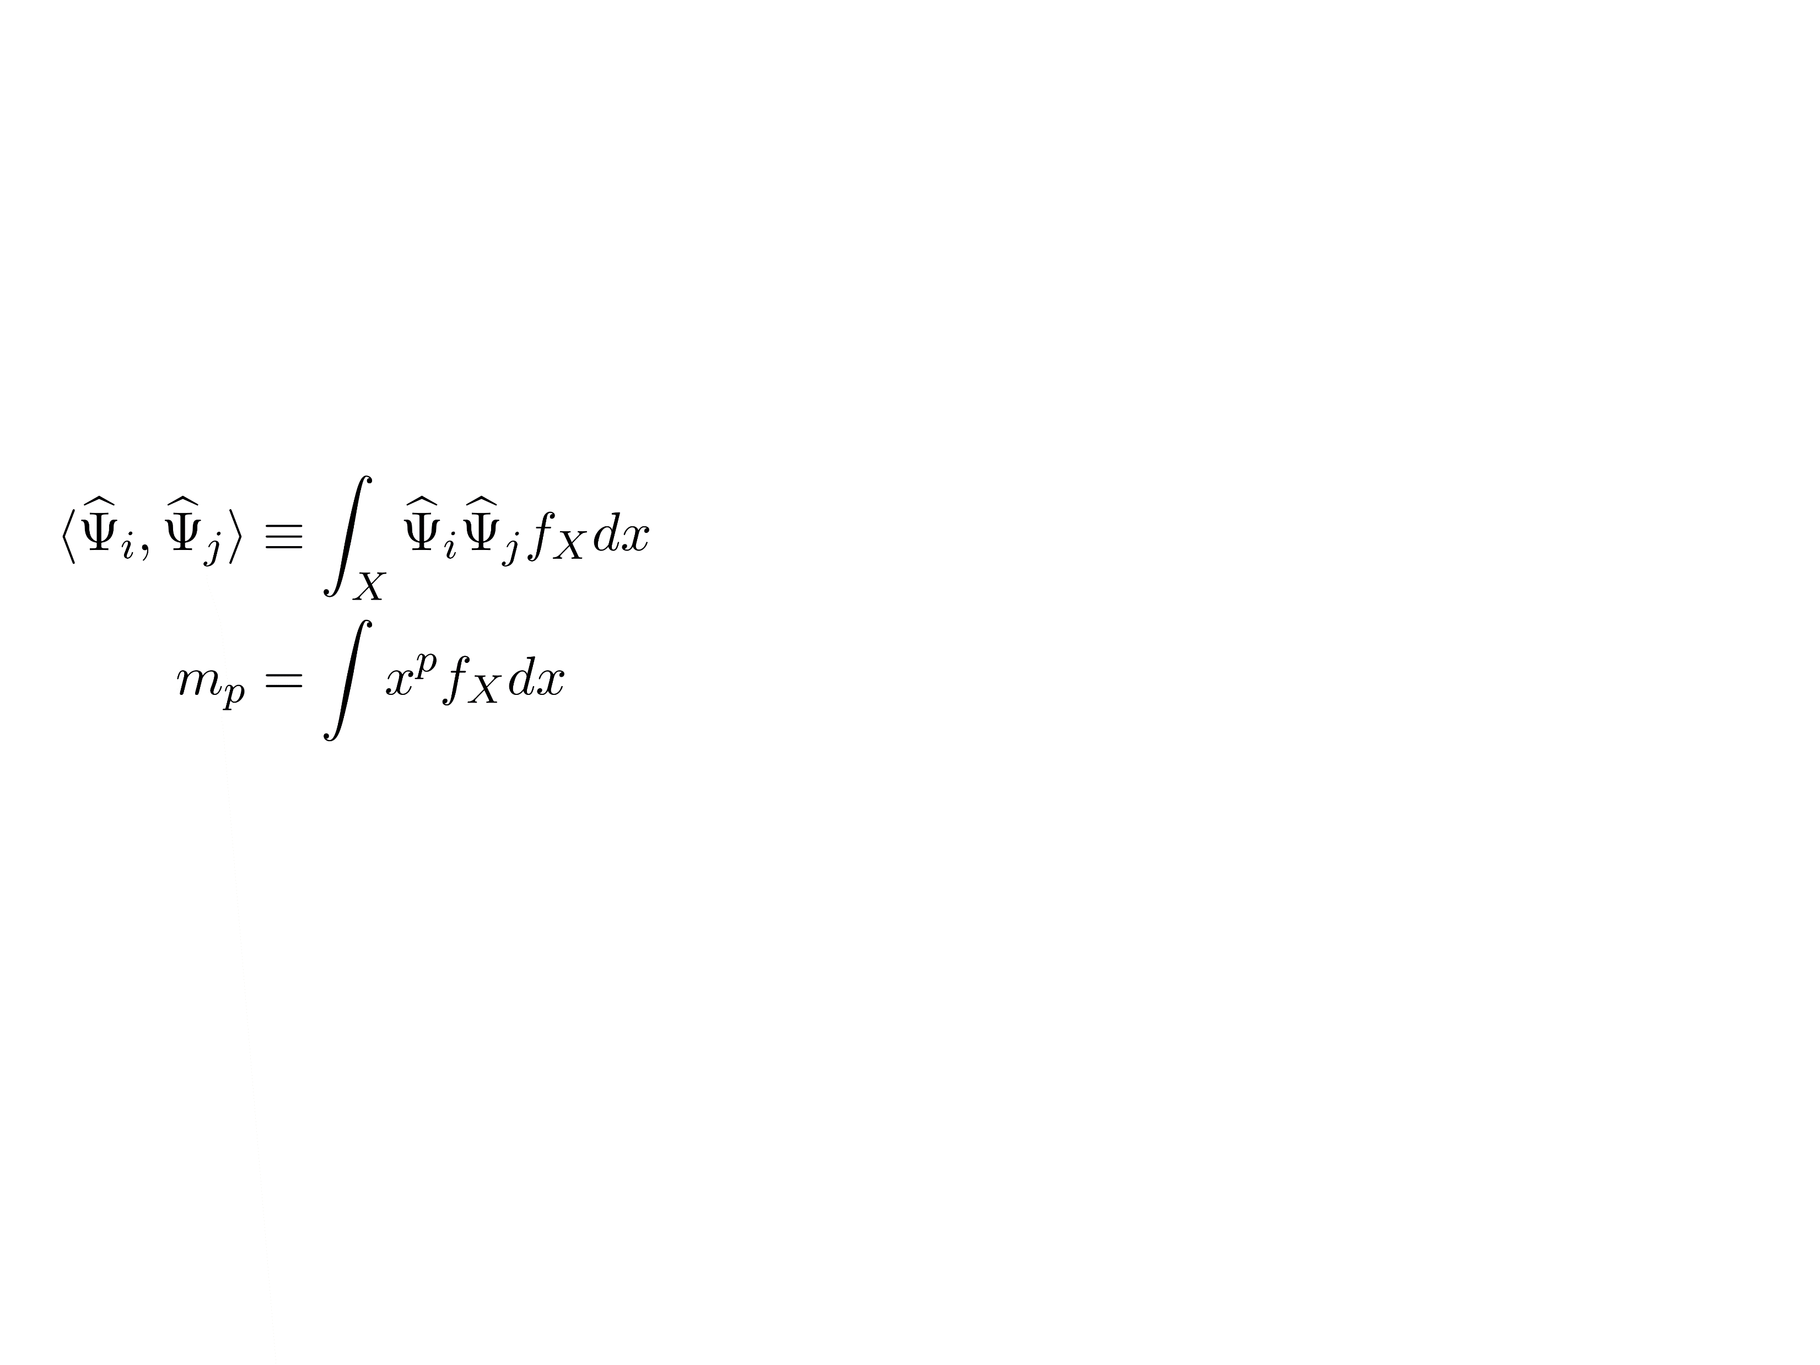
Non-Parametric Polynomials
generalization
Univariate Gram-Schmidt Polynomials:
Multivariate Gram-Schmidt Polynomials for Dependent Variables:
We can use empirical m_{p}.

Slide 30
Contributions
Studied surrogate modeling for offshore design problems using a spectral method: Polynomial Chaos Expansion (PCE)
Developed a distribution-free PCE framework to enhance the traditional spectral method
Proposed a 2-step gradient-based dimension reduction and surrogate modeling for high-dimensional multivariate functions
Validated the proposed methods in offshore dynamics problems for Uncertainty Quantification
Revisit Example: Fatigue damage in a marine riser due to vortex-induced vibration

Slide 31
Distribution-free PCE: Arbitrary PCE (APCE)
APCE show good estimates of mean and variance of QoI (Quantity of Interest): Fatigue Damage (normalized).
APCE does not assume any distribution for inputs, while traditional (parametric) HPCE utilizes jpdf of X and iso-probabilistic mapping, T.
m= 5
 | Truth | APCE | HPCE
mean | 6.797 | 6.806 | 6.814
var | 87.905 | 87.719 | 93.548

Slide 32
Can PCE work for high-dimensional problems?
Extremely difficult
How to deal with this?
(1) Select important variables or
(2) Reduce problem dimension (by transforming original coordinates to “active” ones).

Slide 33
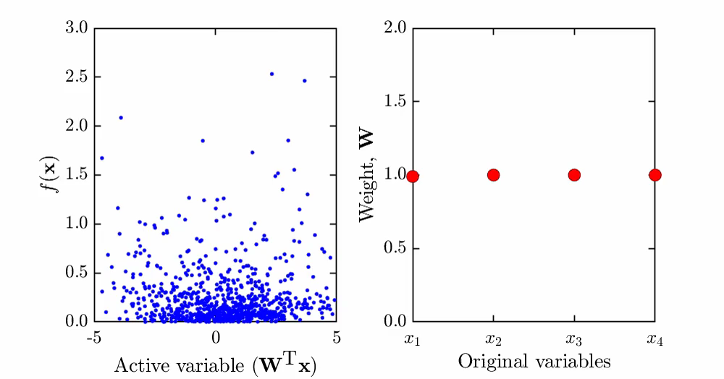
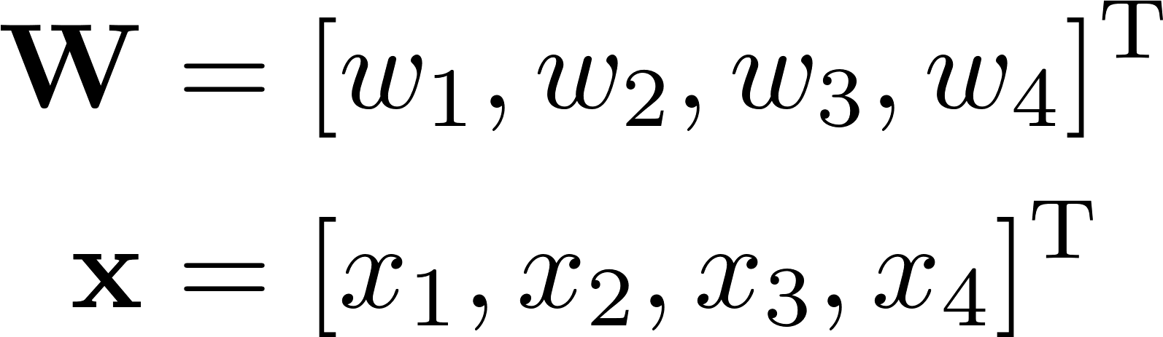

Given:
Trying different linear combinations of X for 1-d manifold
1-d quadratic function approximately
GOAL:
to find appropriate W

Slide 34



Dimension Reduction
Dimension Reduction Using Gradient
uses gradient to find W:

Slide 35




Define a Subset: ‘‘Active Subspace’’
The function, its gradient vector, and a pdf:
The covariance matrix and its eigendecomposition:
Eigenvalues describe the function’s hidden structure (with associated eigenvectors):
Interpretation:
how much f changes with respect to each direction in a mean-squared sense.

Slide 36




Interpretation: Coordinate Rotation
Direction
of variability
Rotate
Direction
of flat

Slide 37





Summary
Input
Output
subset
‘‘Active Subspace’’
Dimension is too large for
surrogate modeling
Dimension is moderate

Slide 38

Gradient Calculation must still address the ‘‘curse of dimensionality’’
Model-order reduction first; search for active subspace next
Input
Output
Reduced
Input
subset
‘‘Active Subspace’’

Slide 39
Contributions
Studied surrogate modeling for offshore design problems using a spectral method: Polynomial Chaos Expansion (PCE)
Developed a distribution-free PCE framework to enhance the traditional spectral method
Proposed a 2-step gradient-based dimension reduction and surrogate modeling for high-dimensional multivariate functions
Validated the proposed methods in offshore dynamics problems for Uncertainty Quantification

Slide 40







Stochastic Time Series Simulator for Long-term Response Prediction
Long-term
Environmental
variables
Short-term
Wave process
simulations
Response simulation
T-minute
extreme response
Short-term
response distribution
Long-term
response distribution
Integrate
Joint PDF
of environment
Hundreds of harmonics are necessary
A few important harmonics for Z

Slide 41





Model Order Reduction in Fourier Series

Slide 42











Gradient Approximation
Standard Normal
Uniform
Response
One function call
2+2r function calls

Slide 43


Establish Gradient Vectors
1st
2nd
3rd
Nth
…
C= GG^{T}/N
C= WΛW^{T}
Total function calls: N$×$(1 + 2 + 2r)

Slide 44



Surrogate Modeling in Reduced Dimension Space
Model order reduction
Dimension reduction
Surrogate modeling

Slide 45
Contributions
Studied surrogate modeling for offshore design problems using a spectral method: Polynomial Chaos Expansion (PCE)
Developed a distribution-free PCE framework to enhance the traditional spectral method
Proposed a 2-step gradient-based dimension reduction and surrogate modeling for high-dimensional multivariate functions
Validated proposed methods in offshore dynamics problems for Uncertainty Quantification
Examples: Long-Term Extreme Response Prediction in Offshore Dynamics

Slide 46


North Sea
A jpdf was proposed by Haver and Nyhus (1986).
Barents Sea
Wave scatter diagram at North Sea
North Sea
Source: Norwegian Meteorological Institute

Slide 47


Model Exploration: Max Wave Elevation
H_{s}
H_{s}= 12.6 (m) T_{p}= 15.0 (s)
Sites
North Sea
Barents Sea
Eureka
T_{p}
Wave Spectra
Red circles: P[H_{s}>h]>10⁻⁴
Bretschneider Pierson-Moskowitz JONSWAP
Short-Term Interest
Wave elevation Floating structure Energy extractor

Slide 48
Model Order Reduction: Max Wave Elevation
H_{s}= 12.6 (m) T_{p}= 15.0 (s)
N_{ω}= 15
N_{ω}= 20
N_{ω}= 25
N_{ω}= 30
N_{ω}= 35
N_{ω}= 40
N_{ω}= 45
N_{ω}= 50
Sites
North Sea
Barents Sea
Eureka
Wave Spectra
Bretschneider Pierson-Moskowitz JONSWAP
Short-Term Interest
Wave elevation Floating structure Energy extractor

Slide 49

Dimension Reduction: Max Wave Elevation
Sites
North Sea
Barents Sea
Eureka
Wave Spectra
Bretschneider Pierson-Moskowitz JONSWAP
Short-Term Interest
Wave elevation Floating structure Energy extractor

Slide 50

Extreme Response of SDOF System
H_{s}
m = 70.36 (kg); k = 10 (N/m);
c = 2 x 0.01 x sqrt(k x m); w_{n}= 0.38 rad/s = 0.06 Hz= 16.7 (sec)
Higher H_{s} doesn’t necessarily produce higher z
H_{s}= 12.6 (m) T_{p}= 15.0 (s)
Sites
North Sea
Barents Sea
Eureka
T_{p}
Wave Spectra
Red circles: P[H_{s}>h]>10⁻⁴
Bretschneider Pierson-Moskowitz JONSWAP
Larger z values occur for T_{p} ranges around the natural period
Short-Term Interest
Wave elevation Floating structure Energy extractor

Slide 51
Model Order Reduction: Extreme Response of SDOF System
H_{s}= 12.6 (m) T_{p}= 15.0 (s)
N_{ω}= 10
N_{ω}= 15
N_{ω}= 20
N_{ω}= 25
N_{ω}= 30
N_{ω}= 35
Sites
North Sea
Barents Sea
Eureka
Wave Spectra
Bretschneider Pierson-Moskowitz JONSWAP
Short-Term Interest
Wave elevation Floating structure Energy extractor

Slide 52

Dimension Reduction: Extreme Response of SDOF
Sites
North Sea
Barents Sea
Eureka
Wave Spectra
Bretschneider Pierson-Moskowitz JONSWAP
Short-Term Interest
Wave elevation Floating structure Energy extractor

Slide 53
Contributions
Studied surrogate modeling for offshore design problems using a spectral method: Polynomial Chaos Expansion (PCE)
Developed a distribution-free PCE framework to enhance the traditional spectral method
Proposed a 2-step gradient-based dimension reduction and surrogate modeling for high-dimensional multivariate functions
Validated the proposed methods in offshore dynamics problems for Uncertainty Quantification

Slide 54
Thank you for your attention
“When nothing is sure, everything is possible.” – Margaret Drabble
Topics I delivered:
Uncertainty Quantification
Polynomial Chaos Expansion
Dimension Reduction Using Gradients
Applied to offshore dynamics:
Fatigue Damage in a Marine Riser Due to VIV
Long-term Extreme Wave Elevation Prediction
Long-term Extreme Structural Response Prediction
Related questions:
Have I ever compared different surrogate methods?
Have I ever applied the methods to MDOF systems?
Can the proposed method be applied to more complex structures?
Have I compared different sites of interest?
Which variable is most important?
How to validate the results when there is no observatory data to compare?

